Slide 1

M0 Example

Slide 2
EXP 1: LED Blink
Call delay function in main loop
Use GPIO to make LED blink
Interface
GPIO (Output)
WDT

Slide 3
EXP 2: 7-Segment Display
Call delay function in main loop
Show 3210 with 7-Segment Display
Interface
GPIO (Output)
WDT

Slide 4
EXP 3: Control LED by Buttons
Key Scan Mechanism
Switch LED On/Off with key pressed
Interface
GPIO (Input/Output)
WDT

Slide 5
EXP 4: Increase Values by Buttons
Value adds 1 when the key is pressed
Display the value with 7-segment display
Interface
GPIO (Output)
WDT

Slide 6
EXP 5: Display Key Value in Hex Form
Display the Key value in Hex form with 7-segment display
Interface
GPIO (Output)
WDT

Slide 7
EXP 6: Countdown the Time
Enable CT16B0 1-ms interrupt
Counter value minus 1 in main loop
Display the counter value with 7-segment display
Interface
GPIO (Output)
WDT
CT16B0 (1ms Interrupt)

Slide 8
EXP 7: Measure Voltage on Potentiometer
Display the ADC measured value with 7-segment display
Interface
GPIO (Output)
WDT
ADC
CT16B0 (1ms Interrupt)

Slide 9
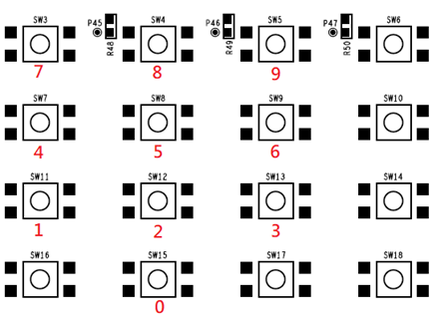
EXP 8: Adjust Pitch of the Buzzer
Adjust the pitch of the buzzer with Buttons
Interface
GPIO (Input)
CT16B0 PWM
CT16B1 (1ms Interrupt)

Slide 10
EXP 9: UART Transceiver
UART 8-bit data/1 STOP bit/Odd parity
Baud rate 115200
Receive then Transmit the same character
Interface
UART

Slide 11
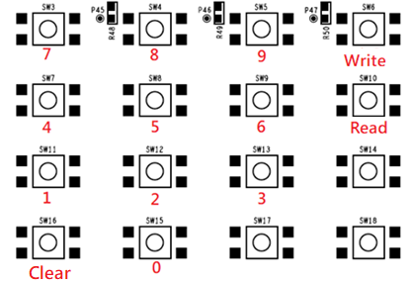
EXP 10: R/W EEPROM with Button Matrix
Enter memory address to read/write EEPROM with Button matrix.
Read/Write value 0x80
Interface
GPIO (Input)
CT16B1 (1ms Interrupt)
I2C (Master mode)

Slide 12
EXP 11: R/W SPI Flash with Button Matrix
Enter memory address to read/write SPI Flash with Button matrix.
Read/Write value 0x80
Interface
GPIO (Input)
CT16B1 (1ms Interrupt)
SPI (Master mode 0)

Slide 13

Thank You

